Slide 1

Marketing Your GSA Contract:
What You Should Know!
Jerome A. Greene
Small Business Technical Advisor Office of Small Business Utilization
U.S. General Services Administration

Slide 2

Today’s Agenda
GSA OSBU Overview
Importance of Market Research
Tools to Conduct Market Research
Key Components for your Strategy
Advantages of Being a GSA Contract Holder
Tips for Success!

Slide 3
GSA OSBU Overview
According to the Small Business Act as amended by Public Law 95-507, the Office of Small & Disadvantaged Business was established to:
  Advocate, within each Federal Executive Agency, for the maximum practicable use of all designated small business categories within the Federal Acquisition process.
  Ensure inclusion of small businesses as sources for goods and services in Federal acquisitions as prime contractors and subcontractors.
  Manage the small business utilization programs for each respective organization.

Slide 4
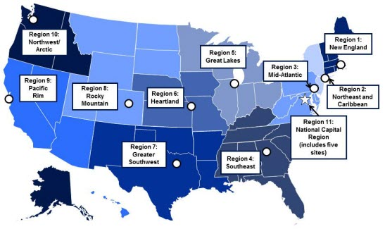
GSA OSBU OVERVIEW
GSA’S Regional Offices
Region 1: Boston, MA
Region 2: New York, NY
Region 3: Philadelphia, PA
Region 4: Atlanta, GA
Region 5: Chicago, IL
Region 6: Kansas City, MO
Region 7: Ft. Worth, Texas
Region 8: Denver, CO
Region 9: San Francisco, CA
Region 10: Auburn, WA
Region 11: Washington, DC

Slide 5
Marketing Your GSA Contract
Steps to Developing Leads in the Federal Market
What contracts are set to expire that I can compete for in the future?
Who are my competitors? Who holds the current contract?
How much are they buying? Have they awarded any set-asides?
Which federal agencies are purchasing my product or service?
The Unknown can cause Frustration & Disappointment

Slide 6

Let the Data Refine Your Overall Strategy!
Marketing Your GSA Contract
Use Data to Develop a Targeted Strategy
Choose the Right Event to Attend
Maximize Time at Matchmaking Events
Know which Agency Forecast Tools to Use
Become More Efficient
And much more!
Notes:
.

Slide 7
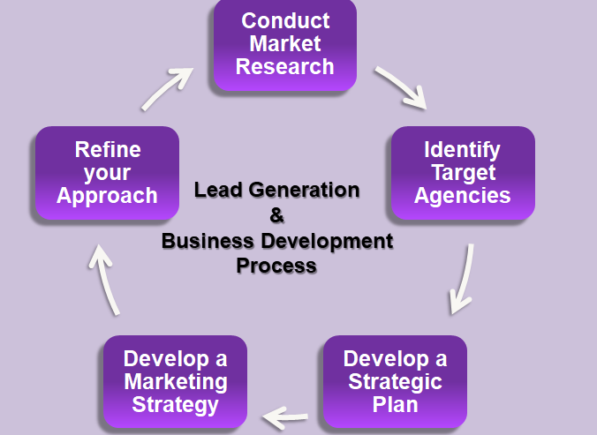
Marketing Your GSA Contract

Slide 8
FPDS-NG Overview
What’s reported to FPDS-NG? Agencies are required to report on all contract actions using appropriated funds, whose estimated value is $3,500 or more as specified in FAR 4.6 Contract Reporting.
Where the data is from: Contracting Officers enter the procurement data or the data is fed from 90+ agency contract writing systems.
Oversight: Operated by GSA IAE with Governance from Acquisition Committee for eGov, Procurement Committee for eGov, Financial Assistance Committee for eGov and IAE CCB.
For more details visit: www.fpds.gov

Slide 9
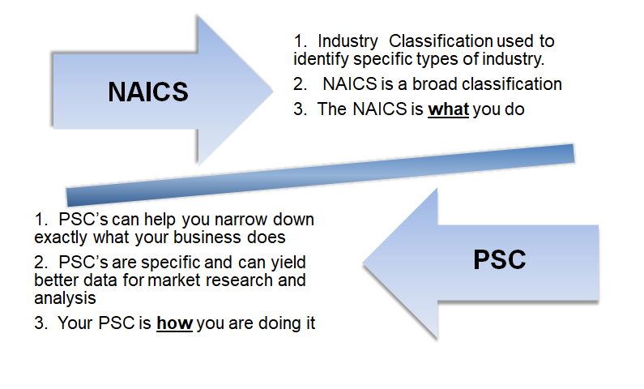
What is needed to use FPDS?
Your Product Service Code (PSC)

Slide 10
FPDS-NG
WHERE TO FIND HELP:
FPDS-NG Data dictionary:
  From www.fpds.gov, click on Worksite submenu, find the Data Dictionary from Left Navigation V1.5 Specifications section.
Report Manual of how to use Ad-Hoc:
  From www.fpds.gov, click on Training, find the Report Manual from Right Manuals section.
Help Desk:
  Phone:866-606-8220
  Website: www.fpds.gov

Slide 11

DATES:
August 6, 2019 @ 2:00 PM
August 29, 2019 @ 2:00 PM
September 17, 2019 @ 1:00 PM
September 26, 2019 @1:00
Upcoming Webinars Dates for
Using the Federal Procurement Data System

Slide 12



Tools to Conduct Market Research
Utilize these tools for your market research:
Latest GSA contract award information
Assess your competition
Offers published sales data of schedules contract sales
SIN Sales
Contractors already on schedule
Ability to assess the size and potential of your target market
Provides federal agency spending priorities and also budgetary information
FPDS serves as the source of USAspending.gov contracts data .
https://www.gsaelibrary.gsa.gov
https://d2d.gsa.gov/report/fas-schedule-sales-query-plus-ssq
https://www.fpds.gov/fpdsng_cms/index.php/en/
Consider the buying trends and forecasted sales for your product/service

Slide 13
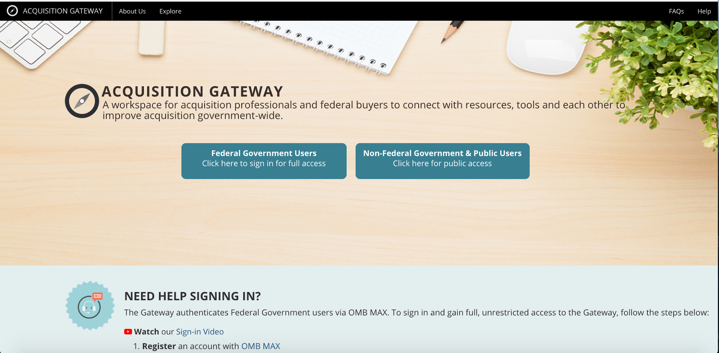
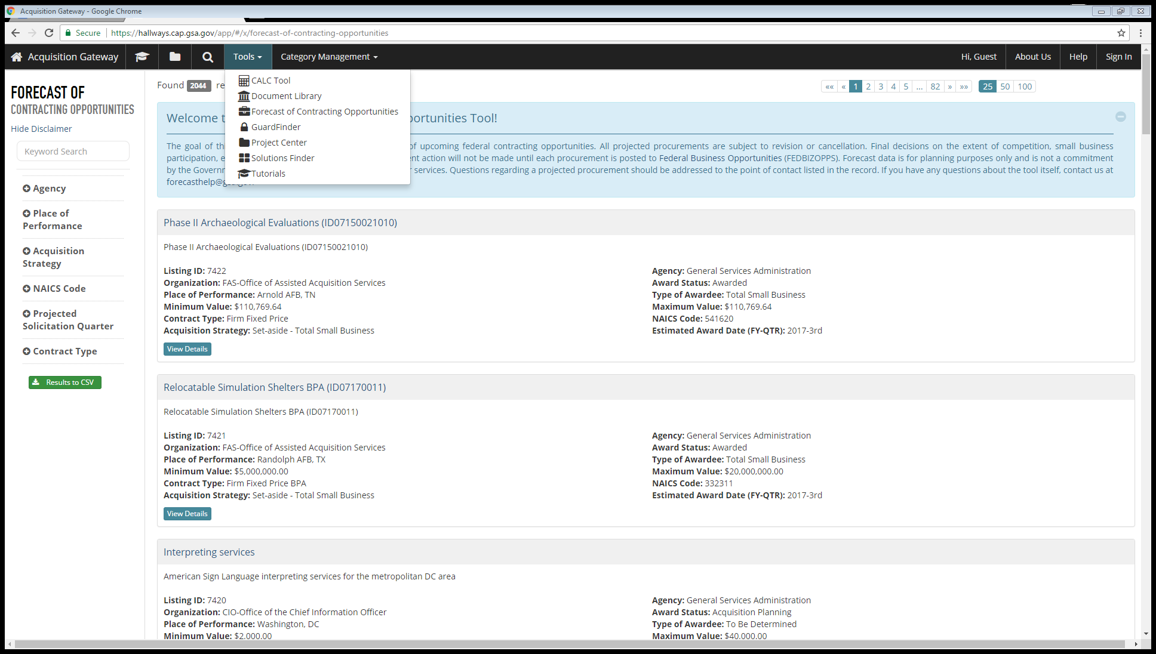
Forecast of Contracting Opportunities
How to Access the Forecast Tool:
Background:
Launched in March 2016
Focuses on acquisition planning and increases awareness of potential prime and subcontracting opportunities.
The goal is to help both GSA buyers and vendors easily communicate around potential contracting opportunities.
The tool includes information for GSA and the Department of Interior.
The goal is to have all federal agencies use the tool.
For more details visit: https://hallways.cap.gsa.gov

Slide 14
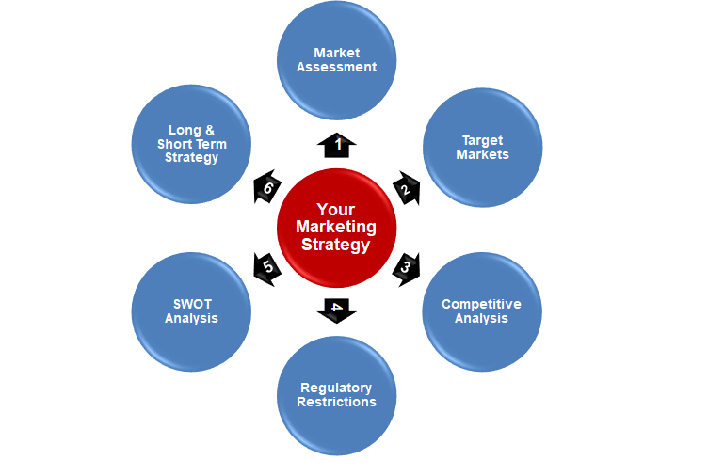
Marketing Your GSA Contract
1

Slide 15
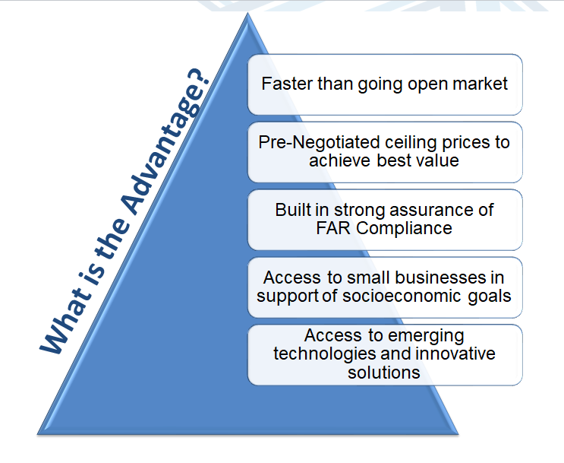
Advantages

Slide 16
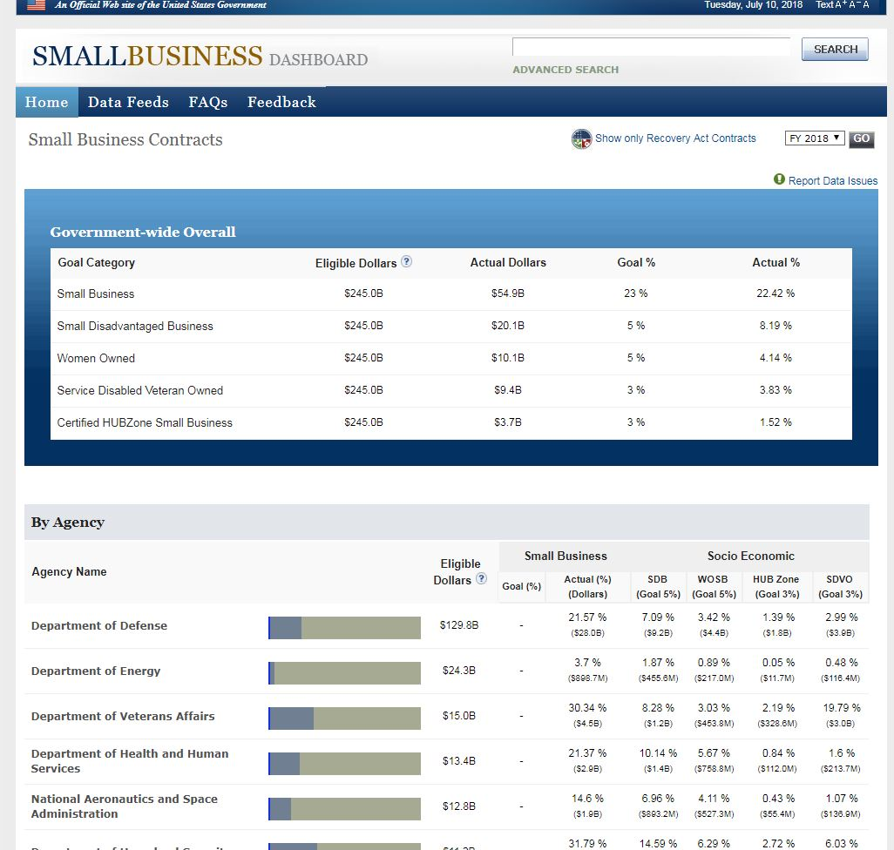
The Small Business Scorecard
Visit. https://smallbusinessdata.gov

Slide 17
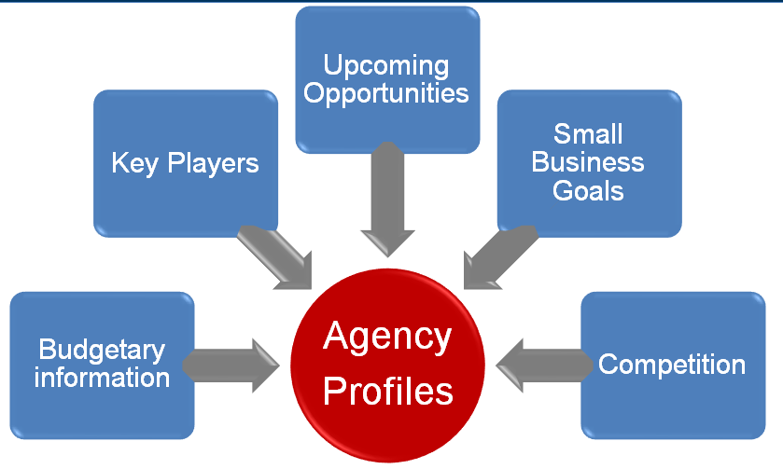

Slide 18

Customer Service Directors (CSDs)
Customer Service Directors (CSDs) provide assistance, resolve problems and answer questions from GSA's customers, our federal, state & local clients.
CSDs also host seminars on a variety of useful topics, and are a valuable source of information on all of GSA's programs.
CSDs market the entire suite of Acquisition Tools provided by GSA to federal, state, and local agencies.
Visit GSA.gov/CSD to find your local CSD.

Slide 19
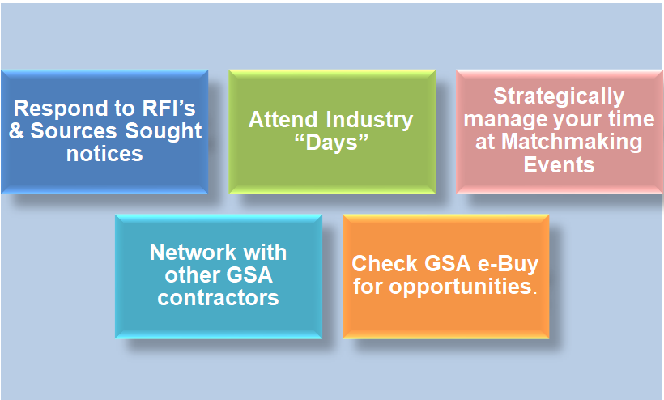
Tips for Success

Slide 20

Federal Supply Schedule Prices List
When you are awarded a GSA Schedule contract, you are required to prepare, print, and distribute a document called the Federal Supply Schedule (FSS) Price List.
When designing your FSS price list, it is best to keep it simple and short.
A one-page flyer covering only the required 26 points specified in your contract, usually is best.
The price list must be distributed to a Customer Mailing List provided to you by the Contracting Officer.
When mailing the FSS Price List to your prospective customers, be sure to include your company brochure and other literature about your product or service.

Slide 21
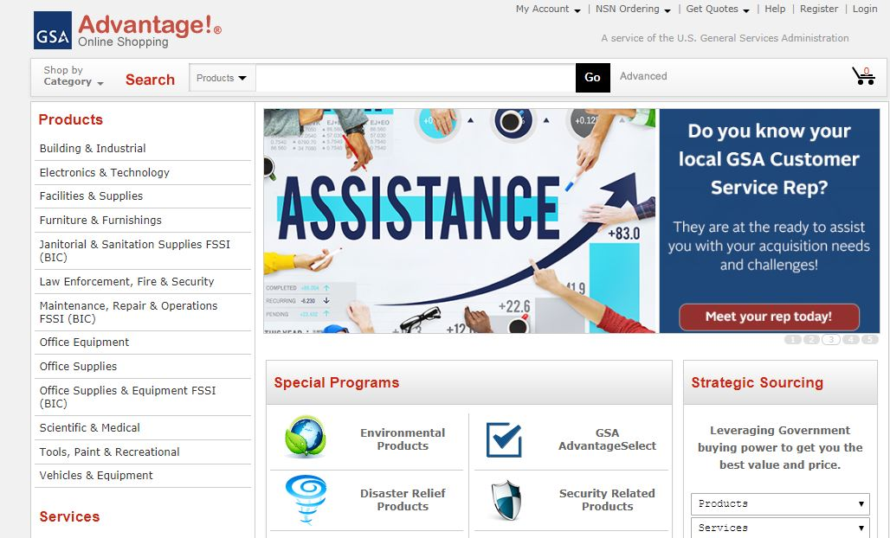
Submitting Your Electronic Catalog to GSA Advantage!
GSA Advantage!® is the online shopping and ordering system that provides access to thousands of contractors and millions of supplies (products) and services.
Government Buyers can search for the products they need, compare prices, and product information, and place their orders.
As a GSA Schedule contractor, you are required to submit your electronic company catalog to GSA Advantage! no later than 6 months after your contract award.
You can submit your electronic company catalog into the GSA Advantage! system, by using the Schedule Input Program (SIP) software, available for downloading at the GSA Vendor Support Center (VSC) web site

Slide 22
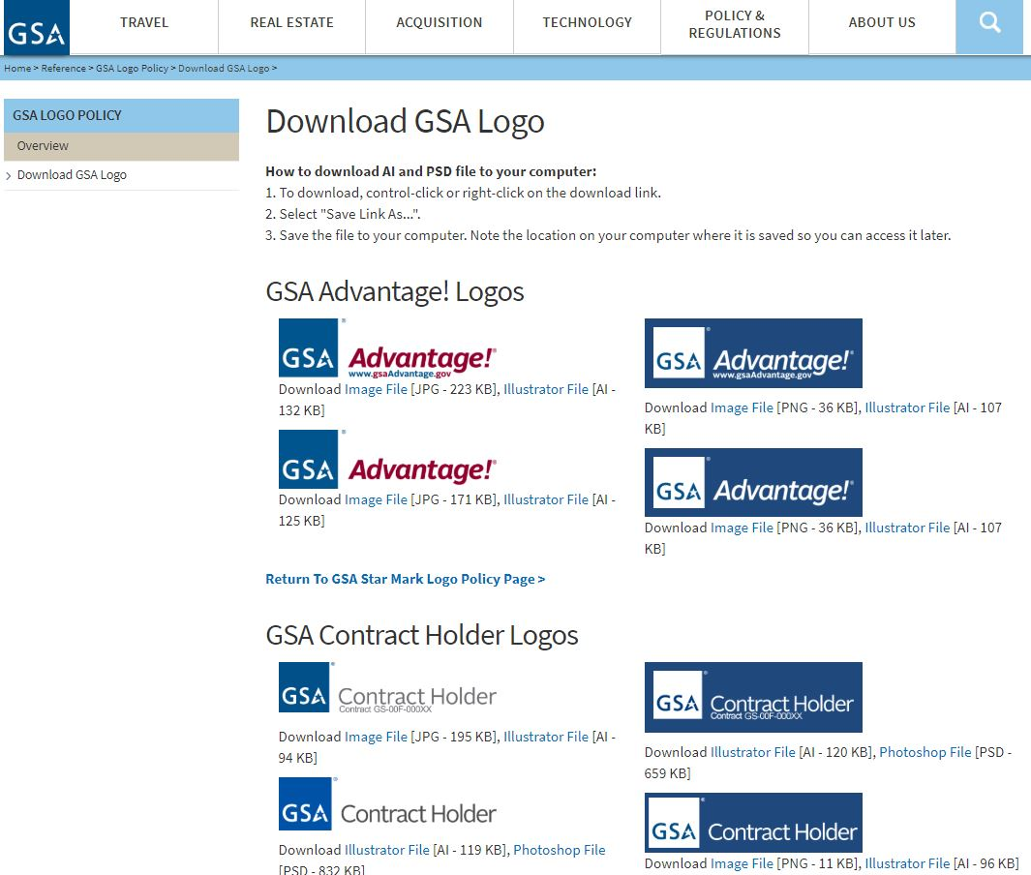
Use of the GSA Logo
Use one of the "GSA Schedule" or "GSA Contract Holder" logos, along with your contract number(s), in your company's marketing materials and brochures.
Be sure to also include a GSA logo on your company's home page
Visit: https://www.gsa.gov/logo

Slide 23

Make Your Website GSA Friendly!
Use one of the GSA logos with your contract number on your home page.
Provide a link from your company’s website to your company’s product listing on the GSA Advantage! website.
Establish a special company email for GSA inquiries.
Use any of the special symbols (e.g., energy-efficient, recycled, environmental items) for which your company's products qualify, on your company's website.

Slide 24




Additional Solutions:
www.gsa.gov/events
www.gsa.gov/smallbizresources

Slide 25
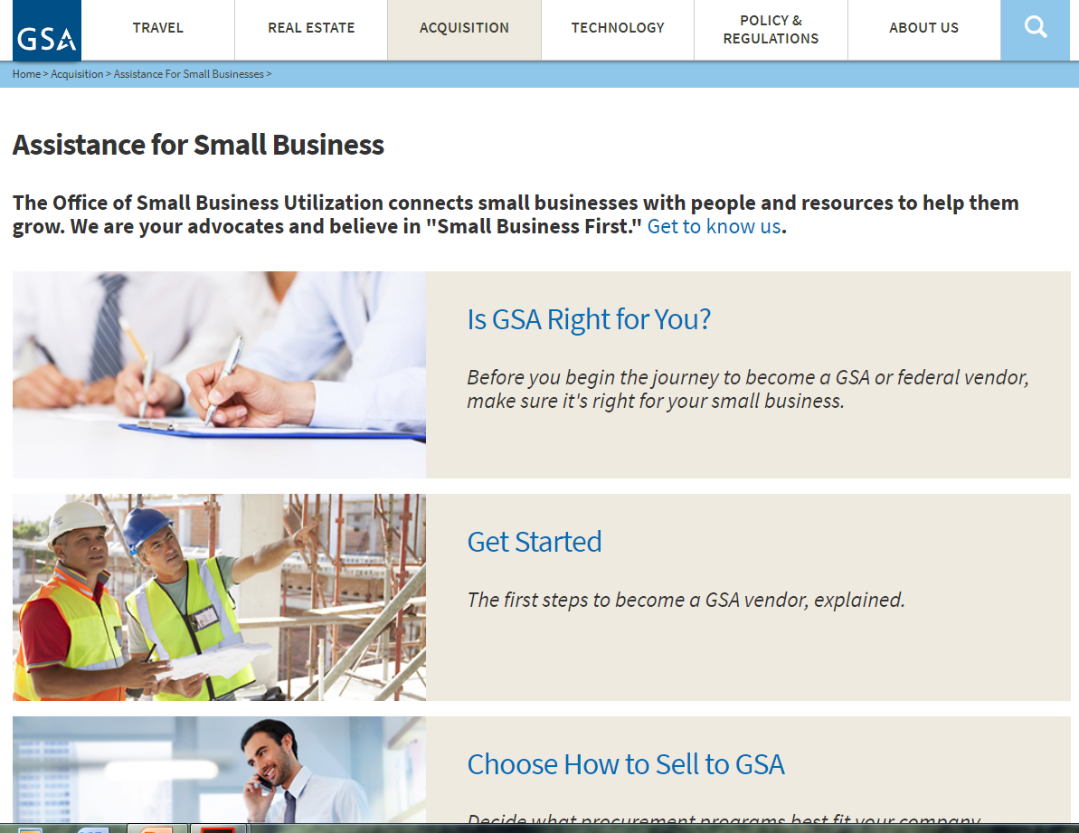
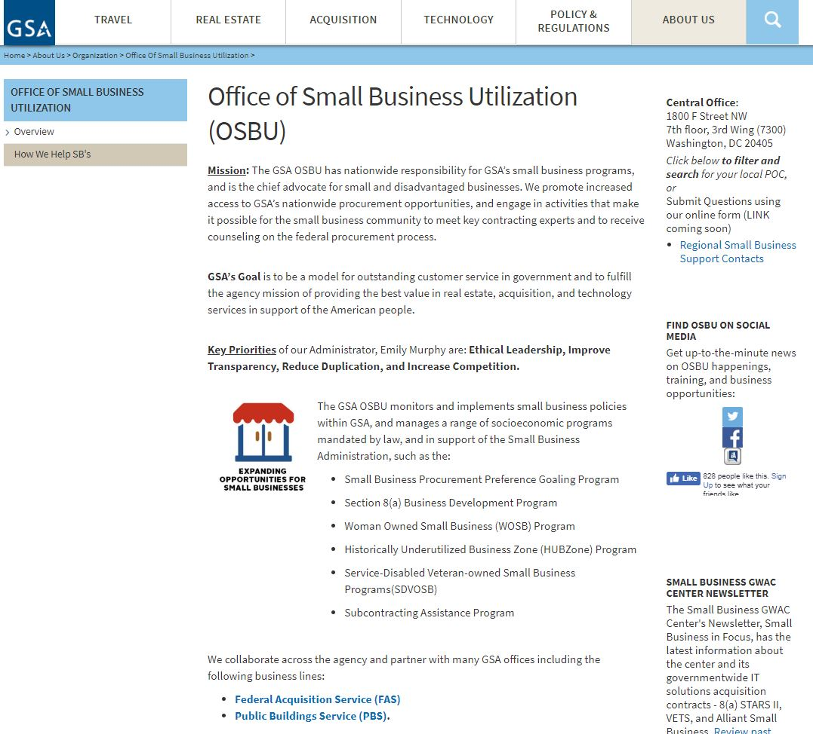
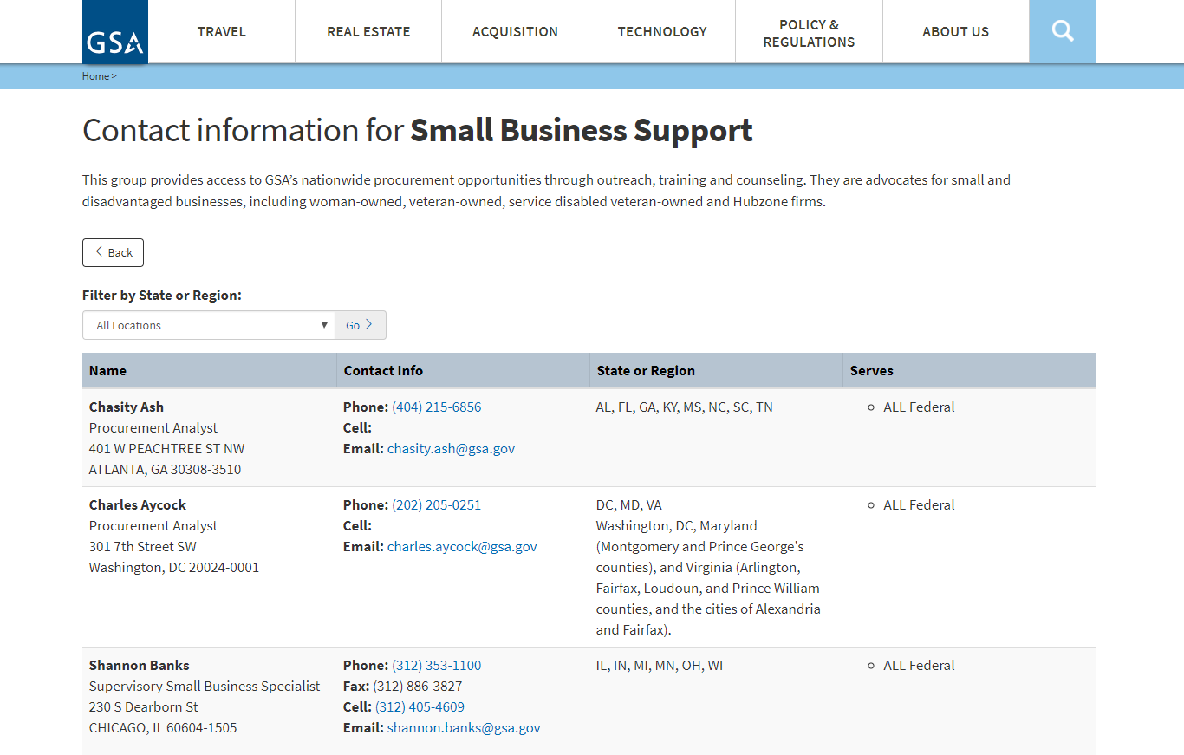
Contact Our Regional Staff
Still Have Questions?
Select Regional Small Business Support Contacts
Go to gsa.gov/osbu, then select “Get to Know Us.”
Choose your location for the OSBU POC.

Slide 26

DATES:
August 1, 2019 @1:00 PM
August 13, 2019 @ 2:00 PM
August 27, 2019 @1:00 PM
September 12, 2019 @ 1:00 PM
September 24, 2019 @1:00 PM
Upcoming Webinars Dates for
Marketing Your GSA Contract

Slide 27
DATES:
August 6, 2019 @ 2:00 PM
August 29, 2019 @ 2:00 PM
September 17, 2019 @ 1:00 PM
September 26, 2019 @1:00
Upcoming Webinars Dates for
Using the Federal Procurement Data System

Slide 28

DATES:
July 30, 2109 @ 1:00 PM
August 8, 2019 @2:00 PM
August 15, 2010 @2:00 PM
August 22, 2019 @2:00 PM
September 3, 2019 @2:00 PM
September 10, 2019 @1:00 PM
September 19, 2019 @1:00 PM
Upcoming Webinars Dates for
Getting on Schedule!

